Slide 1
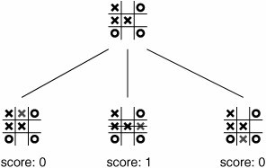
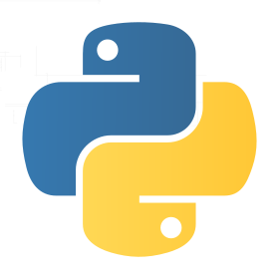

Tic Tac Toe with OpenCV and Dobot Magician
Cody Martin, Zac Clifton - Computer Science
Faculty Advisor: Suranga Hettiarachchi
Abstract
We develop a system, using Dobot Magician (robotic arm), Pixie2 (camera), and Python (program) to play Tic-Tac-Toe with a human player. The game completes when there are no more legal moves, one of the players reaches a win, or there is a tie.
Methodology
We utilize OpenCV Computer Vision Software, Python Language, and the Dobot Programming Interface. If no motion is detected by the camera, we record current game state. The program differentiates between the former and current game state, and chooses an action to be carried out by the robotic arm. The game logic uses an altered AI algorithm, depth first search with Min/Max, using a heuristic value based on the possible outcomes of the game tree(Figure 1). This heuristic is a value that increases if the next possible state is a win and decreases if it is a loss for the Dobot.
Research Results
Out of 26 independent trials, Dobot won 9, the human player won 3, there are 8 ties and 6 inconclusive outcomes (error).
Our results show the system is correct 84% of the time and the error rate is 16%. Table 1 shows winning and losing percentages for each of the players.
Introduction & Motivation
Our motivation for this project is to assist in the learning of Dobot Magician for young minds interested in the field of Robotics.
Another motivation is to develop a way for the human to interact with a robot within a turn based game environment.
Future Work and Conclusion
We plan to alter the environment of the game by replacing the human player with another Dobot player. We also intend to implement a different AI algorithm, such as a semi-supervised learning algorithm, for the logic of the game.
We create an environment for the interaction of human and robotic arm through the use of a camera and software algorithm.
Figure 1
Table 1
References
Cruz, Clederson. “tic-tac-toe-minimax“, github, 2017, Accessed 28 March 2019 from www.github.com/Cledersonbc/tic-tac-toe-minimax
Rosebrock, Adrian. “basic motion detection and tracking with Python and OpenCV”
Sweigart, Al. “Chapter 10: Tic Tac Toe”, Accessed inventwithpython, Accessed 30 March 2019 from https://inventwithpython.com/chapter10.html
First Player | Dobot Win | Player Win | Ties
Dobot | 38.50% | 15% | 46%
Player | 57% | 14% | 25.50%
Our algorithm takes the current state and attempts all possible moves to find the best move from the current state.
The Data shows that when Dobot goes first the game is most likely to be a tie and when the player goes first Dobot will most likely win.

